Slide 1
CSE 105 theory of computation
Fall 2020 Week 4

Slide 2
Table of Contents – Quickly Jump to a video’s slides
Monday | Wednesday | Friday
Video 40 | Video 47 | Video 52
Video 41 | Video 48 | Video 53
Video 42 | Video 49 | Video 54
Video 43 | Video 50 | Video 55
Video 44 | Video 51 | Video 56
Video 45 | Examples | Examples
Video 46 | FAQ | FAQ
Examples
FAQ

Slide 3
This week’s learning goals
Apply the Pumping Lemma in proofs of nonregularity
Identify some nonregular sets
Define push-down automata informally and formally
Trace the computation of a push-down automaton
Describe the language recognized by a push-down automaton
Design push-down automata to recognize specific languages
Determine whether a language is recognizable by a (D or N) FA and/or a PDA

Slide 4
Monday
Videos 040-046
Today’s learning goals
Apply the Pumping Lemma in proofs of nonregularity
Identify some nonregular sets
Today’s textbook sections
Sipser 1.4 Example 1.75, 1.77

Slide 5
040.CSE105.PumpingLemma.mp4
Remember:
A lemma is a generally minor, proven proposition which is used as a steppingstone to a larger result.

Slide 6


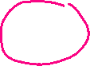
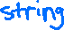
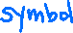


Bounds on DFA
in DFA, memory = states
Automata can only "remember"…
…finitely far in the past
…finitely much information
If a computation path visits the same state more than once, the machine can't tell the difference between the first time and future times it visited that state.

Slide 7
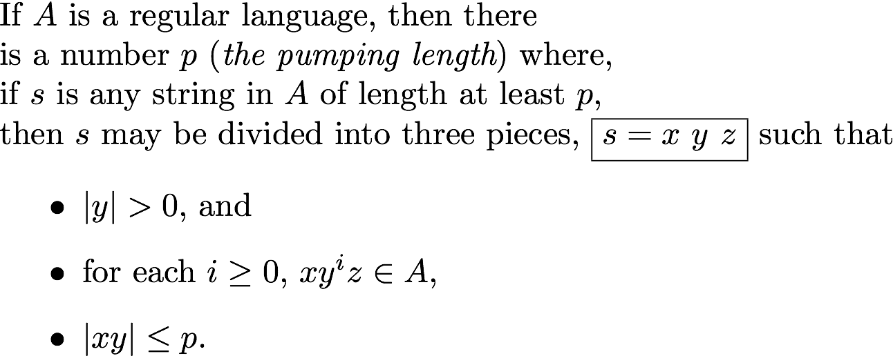
Pumping Lemma Sipser p. 78 Theorem 1.70

Slide 8
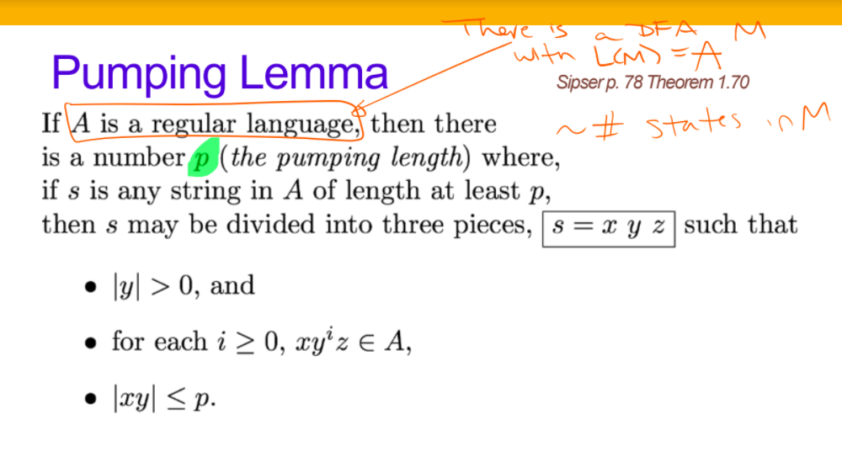










Slide 9



Why is the Pumping Lemma true?
If A is recognized by DFA M with p states and the state diagram below,
the computation of M on any string s of length >= p = |Q|
must have a loop. Divide s into the strings labelling the path before the loop x ,
the loop itself y , and
from the loop to the accept state z
x
y
z

Slide 10
“Pumping”?
Focus on computation path through DFA
x
Idea: if one long string is accepted,
then many other similar strings have to be accepted too
y
z

Slide 11
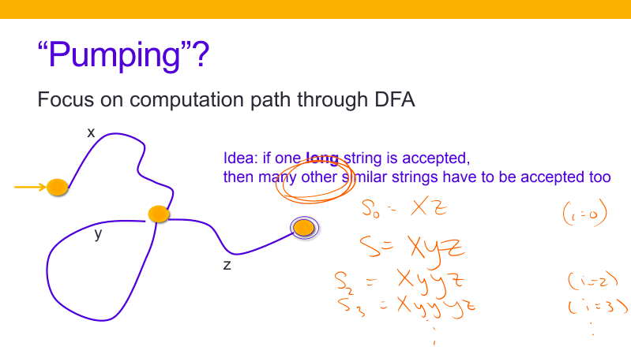

Slide 12
Key Notation and Definitions (040)
If a computation path visits the same state more than once, the machine can't tell the difference between the first time and future times it visited that state.
All regular languages have a pumping length P.
Sipser p. 78 Theorem 1.70

Slide 13
041.CSE105.PumpingLemmaAndFiniteSets.mp4

Slide 14
“Pumping”?
Focus on computation path through DFA
x
Idea: if one long string is accepted,
then many other similar strings have to be accepted too
y
z

Slide 15
Key Notation and Definitions (041)
Every finite language is regular.
Every regular language has a pumping length.

Slide 16
042.CSE105.PumpingLemmaApplicationStrategy.mp4
Remember: (again)
The contrapositive of a statement has its antecedent and consequent inverted and flipped.
i.e. The contrapositive of P → Q is !Q →!P

Slide 17
Pumping Lemma Sipser p. 78 Theorem 1.70
# states in DFA recognizing A
Transition labels along loop

Slide 18
Pumping Lemma Sipser p. 78 Theorem 1.70
# states in DFA recognizing A
Transition labels along loop
Each string that’s long enough (has a length of p or greater) and in the set can be split into 3 pieces, where the middle part can be repeated as many times as we like and give us another string in the set.

Slide 19
Pumping Lemma
If A is recognized by DFA M with state diagram below,
the computation of M on any string s of length >= p = |Q|
must have a loop. Divide s into the strings labelling the path before the loop x ,
the loop itself y , and
from the loop to the accept state z

Slide 20
Pumping Lemma
True for all (but not only) regular sets.
Can't be used to prove that a set is regular Ex 1.49
Can be used to a prove that a set is not regular … how?

Slide 21
Negation flash-back to CSE 20 ☺
Pumping lemma:
“If L is regular, there is p, where p is a pumping length for L"
Given a specific number p, it being a pumping length for L means
So p not being a pumping length of L means

Slide 22
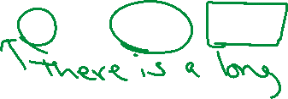
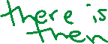
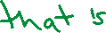
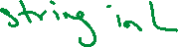
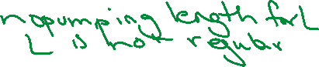
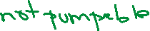
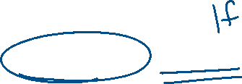
Negation flash-back to CSE 20 ☺
Pumping lemma:
“If L is regular, there is p, where p is a pumping length for L"
Given a specific number p, it being a pumping length for L means
So p not being a pumping length of L means

Slide 23
Proof strategy
To prove that a language L is not regular
Consider arbitrary positive integer p.
Prove that p isn't a pumping length for L.
Conclude that L does not have any pumping length and is therefore not regular.

Slide 24
Key Notation and Definitions (042)
Each string that’s long enough (has a length of p or greater) in the regular set can be split into 3 pieces where that middle part can be repeated as many times as we like and give us another string in the set.
Pumping Lemma can be used to a prove that a set is not regular.
Informally, in order to prove P is not a pumping length, we need to find one long string in language L and prove that, no matter what we try to do, we can’t pump that string.
Pumping means we want to consider all possible ways of splitting the string up that satisfy the conditions of an allowed cutting.
Allowed cutting consists of three parts xyz (the middle part is not empty, the first two parts aren’t too long, etc.)

Slide 25
043.CSE105.NonregularSetExample1.mp4
Remember:
To prove that a language L is not regular:
Consider arbitrary positive integer p.
Prove that p isn't a pumping length for L.
Conclude that L does not have any pumping length and is therefore not regular.

Slide 26
Using the Pumping Lemma
Claim: The set L = {0^{n}1^{n} | n ≥ 0} is not regular.

Slide 27

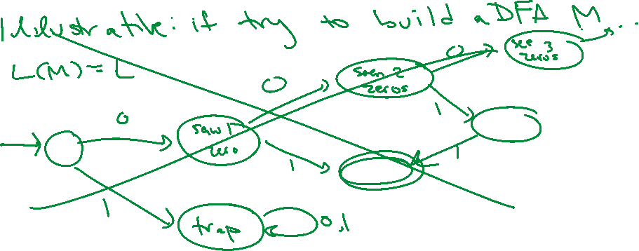
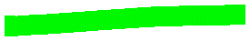
Using the Pumping Lemma
Claim: The set L = {0^{n}1^{n} | n ≥ 0} is not regular.
Trying and failing to build a DFA for a language is not a valid proof strategy for showing that a language is not regular.

Slide 28
Key Notation and Definitions (043)
Trying and failing to build a DFA for a language is not a valid proof strategy for showing that a language is not regular.

Slide 29
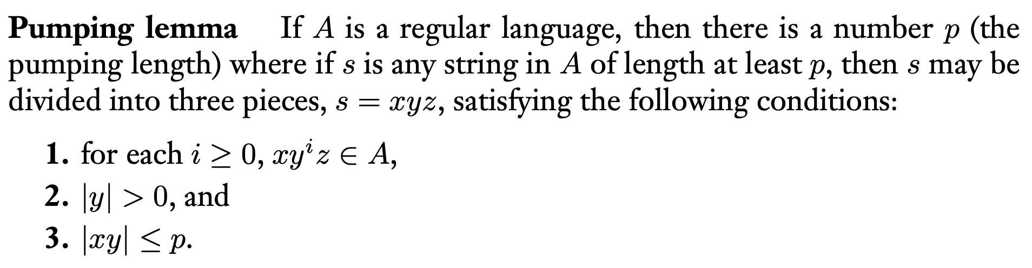
044.CSE105.NonregularSetExample1ProofWithPumpingLemma.mp4
Remember:
Sipser 1.4, Theorem 1.70, pg.78

Slide 30
Using the Pumping Lemma
L = {0^{n}1^{n} | n ≥ 0}
Let p be arbitrary positive integer. CLAIM: p is not a pumping length for L.
How would you prove the claim?
Find a string with length >= p that is not in L.
Find a string with length <p that is in L.
Find a string with length >=p that has a prefix that is in L.
Find a string with length >=p that has a prefix that is not in L.
None of the above.

Slide 31

Using the Pumping Lemma
L = {0^{n}1^{n} | n ≥ 0}
Let p be arbitrary positive integer. CLAIM: p is not a pumping length for L.
How would you prove the claim?
Find a string with length >= p that is not in L.
Find a string with length <p that is in L.
Find a string with length >=p that has a prefix that is in L.
Find a string with length >=p that has a prefix that is not in L.
None of the above.

Slide 32
Using the Pumping Lemma
L = {0^{n}1^{n} | n ≥ 0}
Let p be arbitrary positive integer. CLAIM: p is not a pumping length for L.
WTS
Find a string s such that
s is long |s| >= p
s is in the set s is in L
s is not pumpable No matter how we cut s into three (viable) pieces, some related string obtained by repeating the middle part falls out of L.

Slide 33









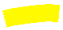





Using the Pumping Lemma
L = {0^{n}1^{n} | n ≥ 0}
Let p be arbitrary positive integer. CLAIM: p is not a pumping length for L.
WTS
Find a string s such that
s is long |s| >= p
s is in the set s is in L
s is not pumpable No matter how we cut s into three (viable) pieces, some related string obtained by repeating the middle part falls out of L.

Slide 34
Using the Pumping Lemma
Claim: The set L = {0^{n}1^{n} | n ≥ 0} is not regular.
Proof: Consider an arbitrary positive integer. WTS p is not a pumping length for L.
Consider the string
s = 0^{p}1^{p}.
|s| >= p ?
s is in L ?
No matter how we cut s into three (viable) pieces, some related string obtained by repeating the middle part falls out of L ?

Slide 35





Using the Pumping Lemma
Claim: The set L = {0^{n}1^{n} | n ≥ 0} is not regular.
Proof: Consider an arbitrary positive integer. WTS p is not a pumping length for L.
Consider the string
s = 0^{p}1^{p}.
|s| >= p ?
s is in L ?
No matter how we cut s into three (viable) pieces, some related string obtained by repeating the middle part falls out of L ?

Slide 36
Using the Pumping Lemma
Claim: The set L = {0^{n}1^{n} | n ≥ 0} is not regular.
Proof: Consider an arbitrary positive integer. WTS p is not a pumping length for L. Consider the string s = 0^{p}1^{p}. Then, s is in L and |s| = 2p >= p. Consider any division of s into three parts
s = xyz with |y|>0, |xy|≤p.
Since |xy|≤p, x=0^{k} , y = 0^{m} , z = 0^{r}1^{p} with k+m+r = p,
and since |y| > 0, m>0. Picking i=0: xy^{i}z = xz = 0^{k}0^{r}1^{p} = 0^{k+r}1^{p} , which is not in L because k+r < p. Thus, no p can be a pumping length for L and L is not regular.

Slide 37


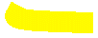

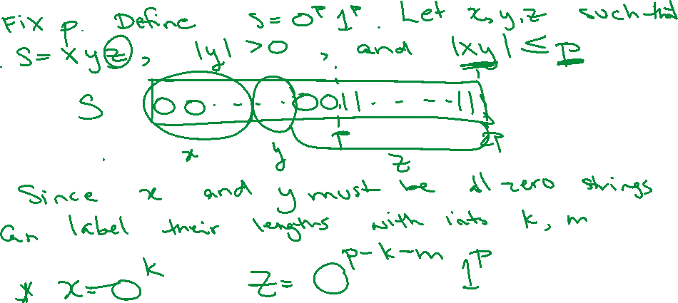


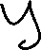



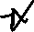



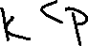
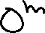


Slide 38
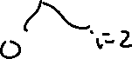
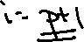
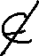
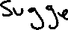
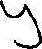
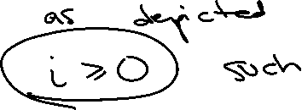
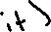
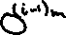
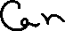
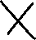
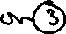
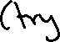
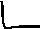
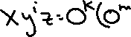
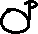
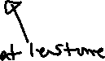
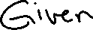
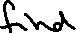
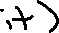
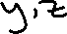
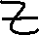
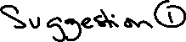
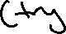
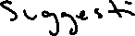
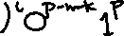
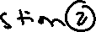

Slide 39
Key Notation and Definitions (044)
Pumping Lemma: If A is a regular language, then there is a number p (the pumping length) where if s is any string in A of length at least p, then s may be divided into three pieces, s = xyz, which satisfy the following conditions:
Sipser 1.4, pg.78
To prove the set L = {0^{n}1^{n} | n ≥ 0} is not regular, consider the string s = 0^{p}1^{p}. Consider any division of s into three parts:
s = xyz with |y|>0, |xy|≤p.
Since |xy|≤p, x=0^{k} , y = 0^{m} , z = 0^{r}1^{p} with k+m+r = p
Since |y| > 0, m>0, picking i=0:
xy^{i}z = xz = 0^{k}0^{r}1^{p} = 0^{k+r}1^{p} which is not in L because k+r < p.
Thus, no p can be a pumping length for L, so L is not regular.

Slide 40
045.CSE105.NonregularSetExample2WithPumpingLemma.mp4

Slide 41
Another example
Claim: The set {w w^{R} | w is a string over {0,1} } is not regular.
Proof: … You must pick s carefully: we want |s|≥p and s in L and s "can't be pumped" … Consider i=…
Which s and i let us complete the proof?
A. s = 0110, i=0 B. s = 0^{p}110^{p}, i=1 C. s = 1^{p}001^{p}, i=3
D. s = 0^{p}1^{p}, i=2 E. I don't know

Slide 42
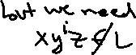










Another example
Claim: The set {w w^{R} | w is a string over {0,1} } is not regular.
Proof: … You must pick s carefully: we want |s|≥p and s in L and s "can't be pumped" … Consider i=…
Which s and i let us complete the proof?
A. s = 0110, i=0 B. s = 0^{p}110^{p}, i=1 C. s = 1^{p}001^{p}, i=3
D. s = 0^{p}1^{p}, i=2 E. I don't know

Slide 43






Slide 44
Key Notation and Definitions (045)
You must pick s carefully: we want |s|≥p and s in L and s can't be pumped.
When picking i, we’re picking the middle part y and repeating it i times. Hopefully, the new string xy^{i}z is not in the language L.

Slide 45
046.CSE105.NonregularSetsSummary.mp4
Remember:
When doing pumping lemma proofs, the main task is picking suitable s and i.

Slide 46
Do we always need Pumping Lemma?
Claim: The set
{w | w has different #s of 0s and 1s OR has a 1 before a 0}
is nonregular.
Proof:

Slide 47
Regular sets: not the end of the story
Many nice / simple / important sets are not regular
Limitation of the finite-state automaton model
Can't "count"
Can only remember finitely far into the past
Can't backtrack
Must make decisions in "real-time"
We know computers are more powerful than this model…
Which conditions should we relax?

Slide 48
Key Notation and Definitions (046)
Limitations of the finite-state automaton model
Can't "count"
Can only remember finitely far into the past
Can't backtrack
Must make decisions in "real-time"

Slide 49

Practice with the Pumping Lemma
Example 1
Ch. 1 Exercises pg. 88

Slide 50

Some More Non-Regular Languages
Example 2
Ch. 1 Problems pg. 90

Slide 51

Yet Another Non-Regular Language
Example 3
Ch. 1 Problems pg. 90

Slide 52

Example 1 Solution
Ch. 1 Solutions pg.97

Slide 53

Example 2 Solution
Ch. 1 Solutions pg. 98

Slide 54
Monday FAQ (040-046)
Q: "Why is pumping lemma a useful concept?"
A: We can use it to show with certainty that a language is nonregular.
Q: "If a language has a pumping length, would the string that has y pumped 0 times also have to be a part of the language?"
A: Yes, for any string in the language that is longer than the pumping length, we can write it as xyz so that repeating y any non-negative integer times gives a different string in the language. In particular, deleting y (by repeating it 0 times) gives a string, xz, that is in the language.

Slide 55
Monday FAQ (040-046) cont.
Q: "How would we know, when trying to show that there is no pumping length, that there are no possible ways to split any of the strings into xyz parts that would work? It seems impossible to check every single combination."
A: We can choose a string s in the language, in which the only possible ways to split s into, x, y, and z parts do not produce strings that are in the language after being pumped.

Slide 56
Monday FAQ (040-046) cont.
Q: "Can the lengths of x and z both be 0?"
A: Yes, and the length of y must be greater than 0.
Q: "Why can we only use pumping lemma to prove that a language is nonregular? Why can't we also use it to prove that a language is regular?"
A: All regular languages will have a pumping length, so if a language does not have a pumping length, it cannot be regular. However, some nonregular languages also have a pumping length. Therefore, we cannot use the fact that a language has a pumping length to show that it is regular.

Slide 57
Wednesday
Videos 047-051
Today’s learning goals
Define push-down automata informally and formally
Trace the computation of a push-down automaton
Describe the language recognized by a push-down automaton
Today’s textbook sections
Sipser 2.2 Figure 2.12

Slide 58
047.CSE105.PDAIntro.mp4
Remember:
A language is called a regular language if some finite automaton (DFA/NFA) recognizes it.

Slide 59
Regular sets: not the end of the story
Many nice / simple / important sets are not regular
Limitation of the finite-state automaton model
Can't "count"
Can only remember finitely far into the past
Can't backtrack
Must make decisions in "real-time"
We know computers are more powerful than this model…
Which conditions should we relax?

Slide 60
The next model of computation
Idea: allow some memory of unbounded size
How?
Generalization of regular expressions → Context-free grammars
Generalization for (D or N)FA → Pushdown Automata

Slide 61
Key Notation and Definitions (047)
Generalization of
regular expressions → Context-free grammars
DFA or NFA → Pushdown Automata

Slide 62
048.CSE105.PDADefinition.mp4
Remember:
PDA uses a stack, that inserts and removes according to the last-in-first-out (LIFO) principle.
A giant stack of plates "Untitled" (1995) by Robert Therien at the Broad Museum

Slide 63

Push-down automaton Sipser p. 111
NFA + stack
Number of states is fixed
Number of entries in stack is unbounded

Slide 64
Informal description of Push-down automaton
Ex (Sipser page 112):
Read symbols from the input. As each 0 is read, push it onto the stack. As soon as 1s are seen, pop a 0 off the stack for each 1 read. If reading the input is finished exactly when the stack becomes empty of 0s, accept the input. If the stack becomes empty while the stack still contains 0s, or if the 1s are finished while the stack still contains 0s, or if any 0s appear in the input following 1s, reject the input.

Slide 65
Informal description of Push-down automaton
Ex (Sipser page 112):
Read symbols from the input. As each 0 is read, push it onto the stack. As soon as 1s are seen, pop a 0 off the stack for each 1 read. If reading the input is finished exactly when the stack becomes empty of 0s, accept the input. If the stack becomes empty while the stack still contains 0s, or if the 1s are finished while the stack still contains 0s, or if any 0s appear in the input following 1s, reject the input.

Slide 66

Informal description of Push-down automaton
Ex (Sipser page 112):
Read symbols from the input. As each 0 is read, push it onto the stack. As soon as 1s are seen, pop a 0 off the stack for each 1 read. If reading the input is finished exactly when the stack becomes empty of 0s, accept the input. If the stack becomes empty while the stack still contains 0s, or if the 1s are finished while the stack still contains 0s, or if any 0s appear in the input following 1s, reject the input.

Slide 67
Push-down automaton Sipser p. 111
NFA + stack
At each step
1. Transition to new state based on current state, letter read, and top letter of stack.
2. (Possibly) push or pop a letter to (or from) top of stack

Slide 68
Push-down automaton Sipser p. 111
NFA + stack
Accept a string iff
there is some sequence of states and some sequence of stack contents which processes the entire input string and ends in an accepting state.

Slide 69




Push-down automaton Sipser p. 111
NFA + stack
Accept a string iff
there is some sequence of states and some sequence of stack contents which processes the entire input string and ends in an accepting state.

Slide 70

Without reading any input, push a $ to the stack
While we read 0s, push each one to stack
(to keep count)
When we read a 1, match it with one of the 0s in stack
Label a, b ; c or a, b → c means
"read an a from the input, pop b from the stack, push c to the stack” when a, b, c are characters or
…
For each 1 we read, match it to a 0 that was on the stack.
If have reached the end of the input and the stack is empty (only $ remains), then #0s = #1s and the machine accepts the string.

Slide 71












Without reading any input, push a $ to the stack
While we read 0s, push each one to stack
(to keep count)
When we read a 1, match it with one of the 0s in stack
Label a, b ; c or a, b → c means
"read an a from the input, pop b from the stack, push c to the stack” when a, b, c are characters or
…
For each 1 we read, match it to a 0 that was on the stack.
If have reached the end of the input and the stack is empty (only $ remains), then #0s = #1s and the machine accepts the string.

Slide 72
Key Notation and Definitions (048)
PDA is like NFA + stack
The number of states is fixed. The number umber of entries in the stack is unbounded.
At each step of computation
1. Transition to a new state based on the current state, the letter read, and the letter at the top of the stack.
2. (Possibly) push or pop a letter to (or from) the top of the stack.
Accept a string if and only if
there is some sequence of states and some sequence of stack contents which processes the entire input string and ends in an accepting state.

Slide 73
Key Notation and Definitions (048)
Label a , b ; c or a , b → c means
Read an a from the input
Pop b from the stack
Push c to the stack
when a, b, c are characters
Note:
We pushed a $ to the stack first without reading any symbols. If we see a $ again, we know that the stack is empty.
Epsilon ε means that the transition is spontaneous relative to the input.

Slide 74
049.CSE105Sp20.PDAStackImplementation.mp4
Remember:
Label a , b ; c or a , b → c means
Read an a from the input
Pop b from the stack
Push c to the stack
when a, b, c are characters

Slide 75
Label a, b ; c or a, b → c means
"read an a from the input, pop b from the stack, push c to the stack” when a, b, c are characters or
…
What edge label would indicate "Read a 0, don't pop anything from stack, don’t push anything to the stack"?
0, ε → ε
ε, 0 → ε
ε, ε → 0
ε → ε, 0
I don't know.

Slide 76


Label a, b ; c or a, b → c means
"read an a from the input, pop b from the stack, push c to the stack” when a, b, c are characters or
…
What edge label would indicate "Read a 0, don't pop anything from stack, don’t push anything to the stack"?
0, ε → ε
ε, 0 → ε
ε, ε → 0
ε → ε, 0
I don't know.

Slide 77
Key Notation and Definitions (049)
Don’t read any symbols, pop a 0 form the stack, push a 0 to the stack. ("Peak" at 0)
ε, 0 → 0
Read a 0, don't pop anything from the stack, don’t push anything to the stack
0, ε → ε

Slide 78
050.CSE105.PDAFormalDefinition.mp4
Remember:
The power set of {x, y, z} is
{{}, {x}, {y}, {z}, {x, y}, {x, z}, {y, z}, {x, y, z}}

Slide 79

Formal definition of PDA Sipser Def 2.13 p. 113

Slide 80


Slide 81
Without reading any input, push a $ to the stack
While we read 0s, push each one to stack
(to keep count)
When we read a 1, match it with one of the 0s in stack
Label a, b ; c or a, b → c means
"read an a from the input, pop b from the stack, push c to the stack” when a, b, c are characters or
…
For each 1 we read, match it to a 0 that was on the stack.
If have reached the end of the input and the stack is empty (only $ remains), then #0s = #1s and the machine accepts the string.

Slide 82

q = the state the transition starts at, x = the symbol to read, y = the symbol to pop

Slide 83





q = the state the transition starts at, x = the symbol to read, y = the symbol to pop

Slide 84


Key Notation and Definitions (050)
Stack alphabet is the collection of symbols that might show up on the stack.
Transition function:
In input
q = the state the transition starts at
x = the symbol to read
y = the symbol to pop
In output
For example {(q1, $)}
q1 is next state the machine is transitioning to
$ is the symbol to push

Slide 85
051.CSE105.PDAExampleTrace.mp4
Remember:
A PDA accepts a string if and only if
There is some sequence of states and some sequence of stack contents that processes the entire input string and ends in an accepting state.

Slide 86
Without reading any input, push a $ to the stack
While we read 0s, push each one to stack
(to keep count)
Label a, b ; c or a, b → c means
"read an a from the input, pop b from the stack, push c to the stack” when a, b, c are characters or
…

Slide 87

Without reading any input, push a $ to the stack
While we read 0s, push each one to stack
(to keep count)
Label a, b ; c or a, b → c means
"read an a from the input, pop b from the stack, push c to the stack” when a, b, c are characters or
…

Slide 88
Computation on the string 001: Step-by-step
Before the computation begins, the stack is empty:
We start at q₀, since that is the start state. We take the transition to q₁ that reads the
empty string, and that transition pops nothing from the stack and pushes a $ to the stack:
Now we are at q₁. There are 2 possible transitions from q1: 1 that reads a 0, and 1 that reads a 1. The next symbol in our string is a 0, so we take the one that reads a 0. It is a self-loop on q₁. By this transition, we pop nothing and push a 0, so now the stack looks like this:
We are still at q₁, and we again will consider which of the 2 transitions to take. The next symbol is once again a 0, so we will take the self-loop that reads a 0, pops nothing, and pushes a 0:
We find ourselves still at q₁, and once more we will consider which of the 2 transitions to take. This time, the next symbol in the string is a 1, so we take the transition to q₂ that reads a 1. This transition requires us to pop a 0 from the top of the stack, and it pushes nothing to the stack:
Now we are at q₂. There are 2 transitions, but because we have already read all the symbols in the string, we can only take a transition that reads the empty string. However, if we try to take the transition to q₃, that transition requires us to pop a $ from the top of the stack. If we look at the current condition of our stack, the symbol at the top is a 0, not a $, so we will be unable to pop a $. Therefore, we cannot take this transition. Because there are no other transitions we can take, the string 001 will be rejected by this machine.

Slide 89
Key Notation and Definitions (051)
ε, ε → $ is an example of a spontaneous transition. It reads the empty string, pops nothing from the stack, and pushes a $ to the stack.

Slide 90

Describing PDAs Informally
Example 1
The languages in Exercise 2.6 for reference
Ch. 2 Exercises pg. 155

Slide 91

Example 1 Solution
Ch. 2 Solutions pg. 160

Slide 92
Wednesday FAQ (047-051)
Q: "What is the difference between the alphabet of the language and the alphabet of the stack in a PDA?"
A: In the alphabet of the stack, we might include some symbols that are not in the alphabet of the language. For example, it is common at the beginning of a computation to push a symbol to the stack that is not part of the alphabet of the language, and that would help us detect stack-emptiness. That symbol would be a part of the stack alphabet. Our stack also might not use all the symbols of the language, and the symbols that are not used on the stack at all do not need to be a part of the stack alphabet.

Slide 93
Wednesday FAQ (047-051) cont.
Q: "When we pop a symbol from the stack, does it have to be from the top?"
A: Yes, and because it is a stack, if a symbol is popped, it is the one that was most recently pushed.
Q: "What is the difference between 0, ε → 0 and 0, ε ; 0?"
A: These transition labels are the same. The arrow and the semicolon are used interchangeably to separate the two parts of the transition related to the stack.

Slide 94
Wednesday FAQ (047-051) cont.
Q: "When a transition requires us to both pop and push a symbol to the stack, which one happens first? Is it the pop or the push?"
A: The pop comes first. If it was the other way around and we wanted to both pop and push symbols during the same transition, we would only ever be able to pop the symbol that we just pushed, and that is not something that we always want to do.
Q: "Does every transition have to make a change to the stack?"
A: No, and an example of this is 0, ε → ε. It reads a 0, pops nothing from the stack, and pushes nothing to the stack. The stack remains unchanged.

Slide 95
Wednesday FAQ (047-051) cont.
Q: "Does the stack have to be empty at the end of the computation in order for the string to be accepted?"
A: No, the computation only needs to read all the symbols in the string and end on an accept state for the string to be accepted.
Q: "Can we push or pop more than 1 symbol to or from the stack during a transition?"
A: We can only pop 1 symbol and push 1 symbol during a single transition.

Slide 96
Friday
Videos 052-056
Today’s learning goals
Design push-down automata to recognize specific languages
Determine whether a language is recognizable by a (D or N) FA and/or a PDA
Today’s textbook sections
Sipser 2.2 Example 2.18 (pg. 116)

Slide 97
052.CSE105.PDADesignExample.mp4

Slide 98
Designing a PDA
Informal description of PDA:
Read symbols from the input. As each 0 is read, push it onto the stack. As soon as 1s are seen, pop a 0 off the stack for each 1 read. If the stack becomes empty and there is exactly one 1 left to read, read that 1 and accept the input. If the stack becomes empty and there are either zero or more than one 1s left to read, or if the 1s are finished while the stack still contains 0s, or if any 0s appear in the input following 1s, reject the input.
L = { 0^{i}1^{i+1} | i ≥ 0 }

Slide 99
L = { 0^{i}1^{i+1} | i ≥ 0 }
How would you change this state diagram to build PDA recognizing L?

Slide 100

Designing/Tracing a PDA
L = { 0^{i}1^{i+1} | i ≥ 0 }
Sample computations?
nondeterminism
stack contents

Slide 101


Slide 102
Key Notation and Definitions (052)
In the PDA shown here:
Since the empty string is not in the language L = { 0^{i}1^{i+1} | i ≥ 0 }, the start state q0 is not an accept state.
A PDA accepts a string if and only if there is some sequence of states and some sequence of stack contents that processes the entire input string and ends in an accepting state. There is no constraint on what the stack should look like by the end of computation.
If there are no outgoing transitions and we haven’t finished reading the input string, the computation gets stuck. We reject the input string.

Slide 103
053.CSE105.PDAArrowLabels.mp4

Slide 104
Push-down automaton Sipser p. 111
NFA + stack
Accept a string iff
there is some sequence of states and some sequence of stack contents which processes the entire input string and ends in an accepting state.
Transitions labelled a, b → c
mean "read an a from the input, pop b from the stack, push c to the stack"
The language recognized by a PDA is the set of strings it accepts

Slide 105
State diagram arrow labels
In the state diagram of a PDA with input alphabet Σ and stack alphabet Γ
means that if in state q and
read the input symbol a while the
top symbol of the stack is b, pop the
b off the stack and replace it with c
updating the state to be q’.
a,b→c
What would the label ε,ε→c mean?
If reading the empty string from q and the stack is empty, push c to the stack and move to state q’.
If in state q and have finished reading the input string, push c to the stack (without popping any symbol off) and move to state q’
None of the above.
q
q'

Slide 106


Slide 107
Key Notation and Definitions (053)
a,ε→c The highlighted epsilon symbol ε is not being used to represent the empty string when used as a label on an arrow.
When we have ε as indicator in the second component, we’re not even going to look at what’s at the top of the stack at that point.
a,ε→c means consume the symbol a and without inspecting the stack, then follow the state transition arrow and push a c to the top of the stack.

Slide 108
054.CSE105.PDADesignAndReverseEngineering.mp4
Remember:
The language recognized by a PDA is the set of strings it accepts.

Slide 109
PDA Design sequence
Given language L, to build a PDA recognizing it
Understand L: e.g. Identify strings in L, strings not in L
Sketch high-level algorithm that determines membership in L
Translate to informal description of PDA
Translate to state diagram and/or formal definition of PDA
Confirm consistency with test cases.

Slide 110
Informal description of PDA Sipser p. 115
Step-by-step description of how computations process input, without drawing state diagram.
Should be able to reconstruct state diagram precisely from description.
Conventions:
Can "test for end of stack" without providing details
How? We can always push the end-of-stack symbol, $, at the start.
Can "test for end of input" without providing details
How? Can transform PDA to one where accepting states are only those reachable when there are no more input symbols.

Slide 111
Or backwards
Given state diagram of PDA, to infer L it recognizes
Trace computation of PDA for sample strings.
Translate state diagram to informal description of PDA
Express set of strings that are each accepted mathematically
Confirm consistency with test cases.

Slide 112


Slide 113


Slide 115


Slide 116
Key Notation and Definitions (054)
Informal description of PDA:
A step-by-step description of how computations process input, without drawing the state diagram.
Should be able to reconstruct a state diagram precisely from its description.
Given the state diagram of PDA, to infer the language L that it recognizes:
Trace the computation of PDA for sample strings.
Translate the state diagram to informal description of PDA.
Express the set of strings that are each accepted mathematically.
Confirm its consistency with test cases.

Slide 117
055.CSE105Sp20.PDAExampleNondeterminism.mp4
Remember:
While we read 0s, push each one to stack
(to keep count)
Without reading any input, push a $ to the stack

Slide 118


Slide 119


Slide 120
Key Notation and Definitions (055)
To make sure that an input string is rejected, exhaust all possible computation paths and confirm that none of them give a successful computation (end in accept state).

Slide 121
056.CSE105Sp20.PDAGeneralConstructions.mp4
Remember:
The output of transition function
is the power set of states and stack alphabet.

Slide 122
General PDA design
Recall: aL = { aw | w is a string in L}
Suppose M = (Q, Σ, Γ, delta, q0, F).
Goal: build PDA M₁ with L(M₁)= aL
Idea

Slide 123


Slide 124
PDA Design sequence
Given language L, to build a PDA recognizing it
Understand L: e.g. Identify strings in L, strings not in L
Sketch high-level algorithm that determines membership in L
Translate to informal description of PDA
Translate to state diagram and/or formal definition of PDA
Confirm consistency with test cases.

Slide 125
General PDA design
Recall: aL = { aw | w is a string in L}
Suppose M = (Q, Σ, Γ, delta, q0, F), L = L(M).
Goal: build PDA M₁ with L(M₁)= aL
Formally define M₁ = (

Slide 126


Slide 127
Key Notation and Definitions (056)
Given a language L, to build a PDA that recognizes it:
Understand L: e.g. Identify strings in L, strings not in L.
Sketch a high-level algorithm that determines membership in L. Translate it to an informal description of a PDA.
Translate it to a state diagram and/or formal definition of a PDA.
Confirm its consistency with test cases.

Slide 128


Tracing the Computation of a PDA
Example 1
Figure 2.17 from Section 2.2 pg. 116

Slide 129
Friday FAQ (052-056)
Q: "Can we have multiple transitions with the same label?"
A: We can. Transitions that read the same symbol and have the same pop and push values can be used to go to different states. A state can have as many outgoing transitions for a symbol as we want it to.
Q: "Does the transition function have to be well-defined?"
A: It should be well-defined, and like the transition function of an NFA, the transition function of the PDA should output the empty set if there are no arrows that correspond to the input 3-tuple of the transition function.

Slide 130
Friday FAQ (052-056) cont.
Q: "Why is the output of the transition function a set of ordered pairs? Why is it not just 1 ordered pair, and what do those values represent?"
A: The first value of each ordered pair in the set represents the state the transition will end up in, and the second value represents the value we want to push to the stack during that transition. The output of the transition function is a set of these ordered pairs because there could be more than 1 possible output for any given input. In the input, we have the state we're transitioning from, the symbol to read, and the symbol to pop from the stack.

